Slide 1
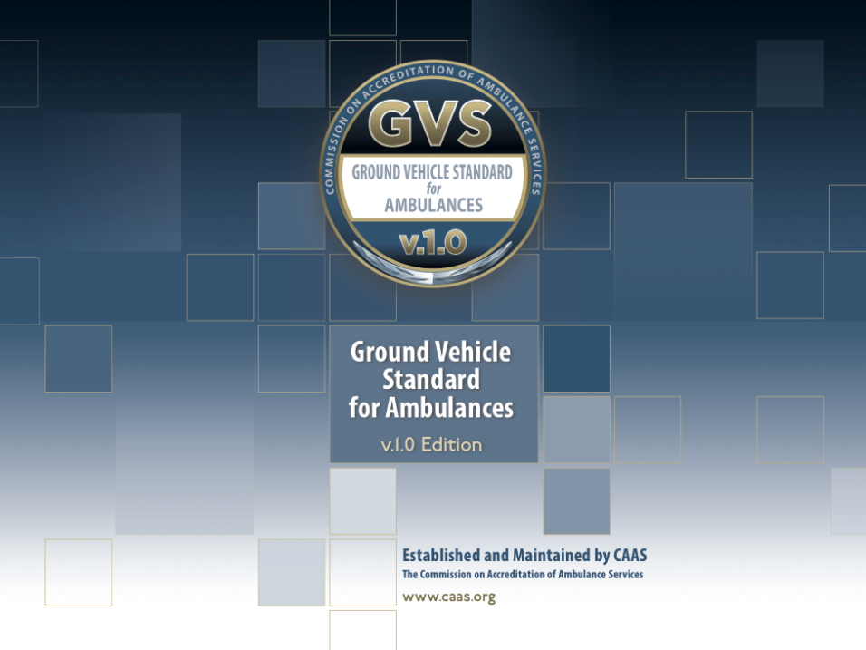

Slide 2

CAAS and the ANSI Process
Sarah L. McEntee
Executive Director, CAAS

Slide 3
CAAS -vs- GVS
CAAS Accreditation Standards:
Standards for enhancing quality and performance for licensed ambulance service providers
Established in 1990
“Gold Standard”- exceeds state EMS licensure requirements
Voluntary, or as required by state/county or local ordinance
When met- the ambulance service/organization is granted accreditation
www.caas.org

Slide 4
CAAS -vs- GVS
GVS v.1.0 Ground Vehicle Standard:
Standard for the design of new ambulances
Establishes minimum standards, performance parameters and essential criteria for the design of ambulances
Provides a practical degree of standardization
When built to the GVS standard- the vehicle will bear the GVS logo
www.groundvehiclestandard.org

Slide 5
CAAS -vs- GVS
Two separate standards
One is not a requirement for the other
Both follow the same process for standard development
American National Standards Institute – ANSI

Slide 6
American National Standards Institute (ANSI)
Private, independent nonprofit organization
Founded in 1918
Facilitates the development of voluntary consensus standards
Official US representation to International Organization of Standardization (ISO)

Slide 7
ANSI- Essential Requirements and Due Process
Facilitates the development of American National Standards (ANS) by accrediting the procedures of Standard Developing Organizations (SDO’s) as Accredited Standards Developers (ASD’s)
SDO’s are required to adhere to a set of requirements called “ANSI Essential Requirements”
Due Process- key to ensuring that all ANS’s are developed in an environment that is:
  Equitable
  Accessible
  Responsive to the requirements of its various stakeholders

Slide 8
ANSI- Essential Requirements and Due Process
The standards development process should have a balance of interests.
Participants from diverse interest categories shall be sought with the objective of achieving balance.
Public review and comment periods are made available and accessible

Slide 9
CAAS and GVS ANSI Status
  Currently an ANSI member
  CAAS is ANSI accredited as a National Standards Developer
  Both CAAS accreditation standards and GVS standard development processes currently follow ANSI guidelines and requirements
  Both standards have been submitted to ANSI for American National Standards (ANS) designation
    GVS v1.0 submitted, contested by NFPA, currently in mediation efforts
    CAAS v3.0 submitted, no comments received, progressing
Both standards are scheduled for review/revision in 2017 and 2018

Slide 10
GVS Development and Status
Mark Postma
GVS Co-Chair, CAAS

Slide 11
GVS Development
Committee of 36 individuals
-Industry stakeholders, government members, vehicle and personnel safety experts, ambulance users, purchasers, vehicle and equipment manufacturers
Convened in DC
- Held 10 two-day meetings over 15 months
Opened twice for public comments
Approved by consensus body vote
Published March 2016/ Effective July 2016

Slide 12
GVS v1.0 Standard
Standard for the design of new ambulances
Establishes minimum standards, performance parameters and essential criteria for the design of ambulances
Provides a practical degree of standardization
Effective July 2016
When built to the GVS standard- the vehicle will bear the GVS logo
Does not require or imply CAAS accreditation which is a separate program
www.groundvehiclestandard.org

Slide 13
GVS v1.0 Standard
GVS documentation foundation is KKK
Applicable to new production vehicles only
Accommodates current chassis offerings
Maintains certain important quality criteria
Includes new NIOSH/SAE Safety Standards
Allows purchaser flexibility with consideration for local requirements

Slide 14
What is Not Included in GVS v1.0
Vehicle speed limitation
Unproven technical feature requirements
Mandates for exterior graphics -color/configuration
Reduced quality of electrical system
Reduced structural integrity of patient compartment floor
Ability for FSAM to “self certify” ambulances to standard

Slide 15
What is Included in GVS v1.0
Purchaser ability to define emergency lighting configuration
Purchaser ability to define exterior graphics design and colors
Continuity of KKK enhanced electrical system requirements- “Class 3 Life Support”
Continuity of KKK enhanced floor structure and loading requirement (AMD 20)
New defined minimum payload requirement of 1,300 pounds for every vehicle including options

Slide 16
What is Included in GVS v1.0
Ability for purchaser to deviate from standard as allowed by state, exceptions to be defined by FSAM
Additional enhancements are suggested, not required
Required compliance for all AMD testing standards #01-25.
FSAM required to provide Type Testing and Certification for each ambulance model from certified independent testing facility.

Slide 17
Required Safety Features
GVS includes new safety requirements that are fully researched and proven by NIOSH:
SAE 3026 Patient Compartment Seating
SAE 3027 Litter Fasteners and Anchorage
SAE 3043 Ambulance Equipment Mounting and Retention
Change order 8 to KKK 1822F incorporates SAE 3026 and 3027 with effective date of July 1, 2015 for new builds
Additional NIOSH/SAE requirements will be included in future revisions of the GVS standard as they are published

Slide 18
Future plans for GVS v.1.0
Three (3) year revision plan is scheduled
Additional SAE standards to be included as they are published
Pediatric standards for patients and passengers
Standards for remounts to be addressed

Slide 19

2015
2017
Ahead
2016
KKK CN#8
KKK CN#9
KKK CN#10
Pediatric
Cot/mount
Seats
Eq. Rest 1
Cabinets
Body
Floor
Excursion
Eq. Rest 2
Remounts
Remounts
www.safeambulances.org

Slide 20
NASEMSO Perspective
Michael Berg
NASEMSO

Slide 21

Remount Forum
June 7, 2017
Position Statement

Slide 22
Position Statement
As we support the coexistence of the GVS v1 and the NFPA 1917 Ambulance Standards, we also support and encourage participation in any process that addresses patient and provider safety through, science, technology, and research. We welcome the opportunity to be an active participant in the creation of standards for remounted ambulances.

Slide 23
Questions?
Michael D. Berg, BS, NRP
Chair, AVL Committee
National Association of State EMS Officials
michael.berg@vdh.virignia.gov

Slide 24
Certification and Compliance- FMVSS
Coleman Sachs
NHTSA Office of Compliance

Slide 25
NHTSA Requirements for Ambulance Body Remounters
Presentation for the Commission on Accreditation of Ambulance Services (CAAS) Ground Vehicle Standard (GVS) Remount Forum - June 7, 2017
Harris Conference Cntr Charlotte, NC
Coleman Sachs, Chief, Import and Certification Division
National Highway Traffic Safety Administration

Slide 26
NHTSA
A small agency in the U.S. Department of Transportation established in 1966
Mission is to improve safety on nation’s highways and reduce fatalities and injuries associated with vehicle crashes
Issues the Federal motor vehicle safety standards (FMVSS)
Prescribe minimum safety performance requirements for motor vehicles and for certain items of motor vehicle equipment
All FMVSS found in 49 CFR Part 571. Each has a number. FMVSS 208 Occupant Crash Protection is at 49 CFR 571.208.
Currently there are 64 FMVSS; 49 are vehicle standards; 15 apply to motor vehicle equipment such as tires, rims, brake hoses, brake fluid, seat belt assemblies, lighting equipment, and glazing.

Slide 27
Statutory Prohibition
49 U.S.C. 30112(a) provides that no person shall manufacture for sale, sell, offer for sale, introduce or deliver for introduction in interstate commerce, or import into the United States any motor vehicle or motor vehicle equipment manufactured on or after the date an applicable FMVSS takes effect unless the vehicle or equipment complies with the standard and is covered by a certification under 49 U.S.C. 30115

Slide 28
Certification, Statutory Requirement
49 U.S.C. 30115 requires a motor vehicle to be certified to the FMVSS by permanently affixing a tag or label to the vehicle by the time of its delivery to a distributor or dealer.

Slide 29
Is an Ambulance Body Remounter a Manufacturer?
Yes. NHTSA’s regulations at 49 CFR 571.7(e) provide that when a new cab is used in the assembly of a truck, the truck will be considered newly manufactured for the purpose of applying the National Traffic and Motor Vehicle Safety Act of 1966 and the Federal motor vehicle safety standards unless the engine, transmission, and drive axle(s) (as a minimum) of the assembled vehicle are not new, and at lest two of these components were taken from the same vehicle.

Slide 30
What kind of a manufacturer is an ambulance body remounter?
An ambulance body remounter is a Final-Stage Manufacturer.
NHTSA’s regulations at 49 CFR 567.3 define a “chassis-cab” as an incomplete vehicle with a completed occupant compartment that requires only the addition of cargo-carrying, work-performing, or load-bearing components to perform its intended function.
The same regulations define a “final-stage manufacturer” as a person who performs such manufacturing operations on an incomplete vehicle that it becomes a completed vehicle.
A “completed vehicle” is defined as a vehicle that requires no further manufacturing operations to perform its intended function

Slide 31
Do Ambulance Body Remounters Have Certification and other Responsibilities under NHTSA’s Regulations?
Yes, as a final-stage manufacturer, an ambulance body remounter assumes legal responsibility for all certification-related duties and liabilities under the Vehicle Safety Act, except to the extent that the incomplete vehicle manufacturer or an intermediate manufacturer has provided equipment subject to a safety-standard or expressly assumed responsibility for standards related to systems and components it supplied and except to the extent that the final-stage manufacturer completed the vehicle in accordance with the prior manufacturers’ incomplete vehicle document or IVD or any addendum to that document. See 49 CFR 567.5(d)

Slide 32
Must an ambulance body remounter affix a certification label to the completed vehicle?
Yes. As a final stage manufacturer, an ambulance body remounter must affix a certification label to each vehicle in a manner that does not obscure the labels affixed by previous stage manufacturers and that contains the following statements:
  Name of the final stage manufacturer, preceded by the words “MANUFACTURED BY” OR “MFD BY”
  Month and year in which the final stage manufacture is completed , spelled out, as in “June 2000,” or expressed in numerals, as in “6/00”
  Gross Vehicle Weight Rating, followed by the appropriate value in kilograms and (pounds), which shall not be less than the sum of the unloaded vehicle weight, rated cargo load, and 150 pounds times the number of the vehicle’s designated seating positions.

Slide 33
Certifications Requirements, Continued
  Gross axle weight rating, followed by the appropriate value in kilograms and (pounds) for each axle, identified in order from front to rear (e.g. front, first intermediate, second intermediate, rear). Example: Front- 5,215 kg (11,500 lb) with 295/75R22.5(G) tires
  One of the following alternative certification statements:
    “This vehicle conforms to all applicable Federal Motor Vehicle Safety Standards in effect in (month, year).”
    “This vehicle has been completed in accordance with the prior manufacturer’s IVD, where applicable. This vehicle conforms to all applicable Federal Motor Vehicle Safety Standards in effect in (month, year)”

Slide 34
Certification Requirements, Continued
    “This vehicle has been completed in accordance with the prior manufacturer’s IVD, where applicable, except for [insert FMVSS(s)]. This vehicle conforms to all applicable Federal Motor Vehicle Safety Standards in effect in (month/year).”
    The date shown in the above statements shall not be earlier than the manufacturing date provided by the incomplete or intermediate stage manufacturer and not later than the date of completion of the final-stage manufacture.
    The certification label must also identify the vehicle’s vehicle identification number or VIN and the vehicle’s type classification, such as “truck.”

Slide 35
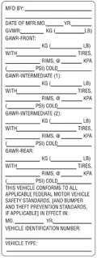
Certification Label

Slide 36
Certification
Performed by the manufacturer and not NHTSA (no type approval)
Manifested by a label permanently affixed to the vehicle in a prescribed location
Identifies the manufacturer, the date of manufacture, the vehicle type
States that the vehicle complies with all applicable FMVSS in effect on the date of manufacture shown above

Slide 37
Location of Label
The label must be affixed to either the hinge pillar, door-latch post or the door edge that meets the door latch post, next to the driver’s seating position, or if none of these locations is practicable, to the left side of the instrument panel. If that location is also not practicable, the label shall be affixed to the inward-facing surface of the door next to the driver’s seating position. If that too is not practicable, the manufacturer must provide notification to NHTSA with a suggested alternative location. 49 CFR 567.4(c).

Slide 38
Certification
The manufacturer must exercise “reasonable care” in certifying a vehicle to an applicable standard.
If NHTSA suspects a noncompliance, it will ask the manufacturer to demonstrate how it exercised “reasonable care.”
Tests are prescribed in many of the standards; these are NHTSA’s notice of what it will do to determine compliance. The manufacturer is free to demonstrate compliance by other means

Slide 39
Certification Requirements (Continued)
If the manufacturer fails to demonstrate that it exercised “reasonable care” in certifying the vehicle or equipment item to the standard in question, it is subject to civil penalties
Penalties are currently set at $21,000 per violation, up to a maximum penalty of $105,000,000 for a related series of violations
A separate violation exists with respect to each vehicle or equipment item that does not comply

Slide 40
Procedural Requirements
Before offering its vehicles for sale in the United States, a vehicle manufacturer must:
Identify itself and its products to NHTSA pursuant to 49 CFR Part 566 Manufacturer Identification
This information is submitted to, and published on NHTSA’s website at https://vpic.nhtsa.dot.gov.
For further information contact NHTSA at 1-888-399-3277 or at manufacturerinfo@dot.gov.

Slide 41
Responsibility for Defects or Noncompliances
As a final stage manufacturer, an ambulance body remounter is responsible for any safety-related defect or noncompliance with a Federal motor vehicle safety standard in the components or equipment it adds to the vehicle or that it introduces into the vehicle as a result of the work it performs.
The final stage manufacturer must furnish NHTSA with notice of the defect or noncompliance under 49 CFR Part 573 Defect and Noncompliance Information Reports within five days of discovering the defect or noncompliance
The final stage manufacturer must also furnish owners of the vehicle with notification of the defect or noncompliance under 49 CFR Part 577, and a remedy for the defect or noncompliance without charge if the vehicle was purchased less than 15 years from the date the manufacturer furnishes notice of the defect or noncompliance to NHTSA.

Slide 42
NHTSA Office of Defects Investigations &
Special Crash Investigations
The NHTSA ODI conducts safety defect investigations and analyzes safety issues in motor vehicles and equipment. Three-pronged mission:
  Identify design or manufacturer defects;
  Assure defects are remedied promptly and effectively; and,
  Assure information relating to defect investigations and safety recalls is readily available to the public
The NHTSA SCI program provides NHTSA with in-depth crash investigation data which is collected from basic police crash reports and comprehensive special reports by crash investigation teams. Final reports include:
  Pre-crash activities of the persons involved;
  Contributing factors to serious or fatal injuries sustained in a crash;
  Environmental or roadway factors; and,
  Vehicle and equipment factors
More information can be found at www.NHTSA.gov or www.EMS.gov

Slide 43
Internet Resources
For information on NHTSA’s importation and certification program: www.nhtsa.gov/cars/rules/import. Information on that site includes a detailed list of answers to frequently asked questions.
A handbook for new motor vehicle or equipment manufacturers can be downloaded at: https://vpic.nhtsa.gov/Manufacturer_Handbook_20161019.pdf
The database identifying all manufacturers who have registered with NHTSA and given us VIN-deciphering information is at: https://vpic.nhtsa.dot.gov/mid/

Slide 44
Contacts
Import and Certification Division
tel: (202) 366-5291
fax: (202) 493-0073
e-mail: importcertification@dot.gov
Coleman Sachs (Division Chief)
  tel: (202) 366-3151
  e-mail: coleman.sachs@dot.gov

Slide 45
Multi-stage Vehicles
Steve Spata
NTEA

Slide 46

CAAS-GVS Remounted Ambulance Forum
Presenter: Steve Spata, Technical Assistance Director, NTEA

Slide 47
CAAS-GVS Remounted Ambulance Forum
Certification process
Compliance
Documentation
Resources

Slide 48
Certification Process
What is certification?
Your company’s representation that a vehicle you manufacture meets all applicable Federal Motor Vehicle Safety Standards (FMVSS)
Different than “certification” to ‘Triple K Spec’, NFPA or CAAS
Labeling — Last step in certification process

Slide 49

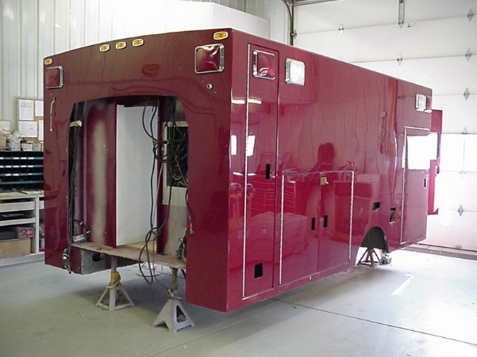
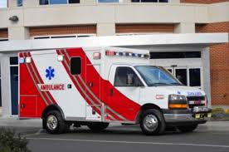
Certification Process
Applies to all new motor vehicles
‘pre-owned’ body
New chassis
New vehicle

Slide 50
Certification Process
Two things to keep in mind:
  All vehicles must be certified in the final stage (i.e., All vehicles have to be manufactured to a condition where they meet all of the FMVSS that apply).
  All manufacturing operations performed on motor vehicles prior to the first purchase (meaning licensed and titled in some State) must be certified (i.e., All stages of manufacturing that a vehicle goes through require a form of certification and labeling that corresponds to that stage).

Slide 51
Certification Process
Steps include: weight distribution, review of Incomplete Vehicle Document (IVD) and body builder information, compliance analysis and documentation, requesting compliance representations from equipment/system suppliers, etc.
FMVSS applicability can include vehicle type, number of designated seating positions and gross vehicle weight rating (GVWR)

Slide 52
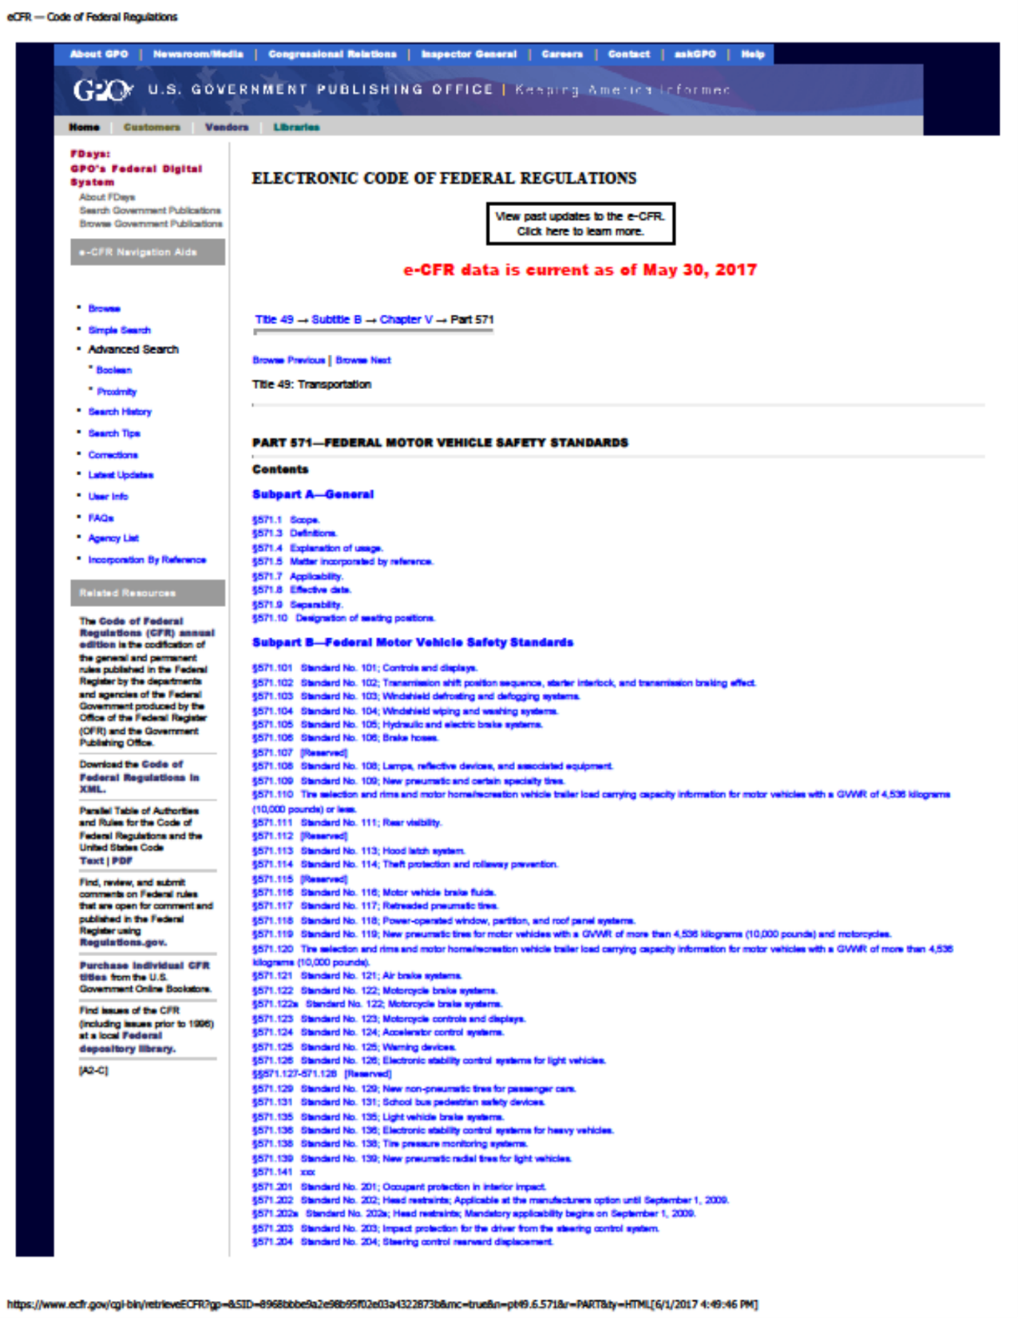
Certification Process
Ambulances classified as “multipurpose passenger vehicles” (MPVs)
Up to ~50 FMVSS that apply to MPVs

Slide 53
Compliance
Incomplete Vehicle Documents

Slide 54
Compliance
Incomplete Vehicle Documents

Slide 55
Compliance
Conformity Statements
Type I • A statement that the vehicle, when completed, will
conform to the standard if no alterations are made
in identified components of the incomplete vehicle.
Type II • A statement of specific conditions of final
manufacture under which the incomplete vehicle
manufacturer specifies that the completed vehicle
will conform to the standard.
Type III • A statement that conformity with the standard
cannot be determined based upon the components
supplied on the incomplete vehicle, and that the
incomplete vehicle manufacturer makes no
representation as to conformity with the standard.

Slide 56
Documentation
Develop compliance rationale
Review IVD conformity statements applicable FMVSS
Determine if Standards met within OEM guidance or if additional testing/analysis is necessary
Save in files

Slide 57

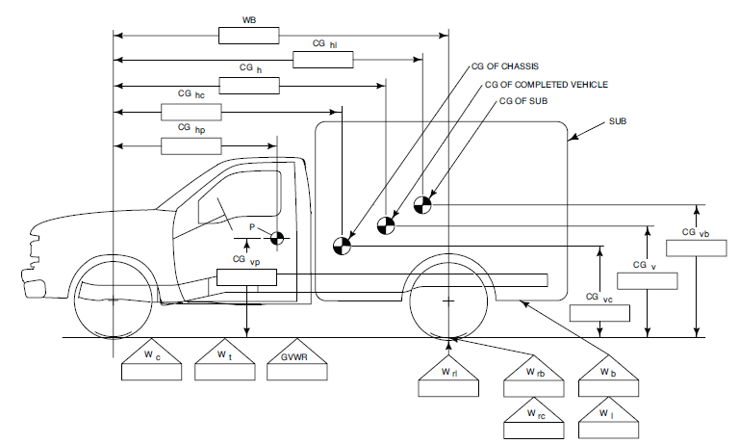
Documentation
Develop compliance rationale
Weight, in particular, plays a critical role in meeting certain FMVSS, especially vehicles < 10K lbs. GVWR (also needed for ‘Triple K’ compliance)
Maximum unloaded vehicle weight (Max UVW), Distribution of weight/Center of Gravity
Newer emission regulations include UVW and frontal area limitations

Slide 58
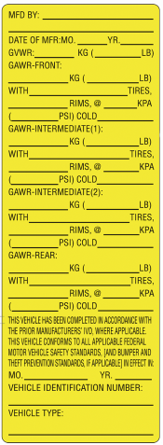
Documentation
Labels for Final Stage Certification for vehicles completed from Chassis Cab, Cutaway or incomplete Van
“This vehicle has been completed in accordance with the prior manufacturers' IVD, where applicable. This vehicle conforms to all applicable Federal Motor Vehicle Safety Standards, [and Bumper and Theft Prevention Standards, if applicable] in effect in (month, year).”

Slide 59
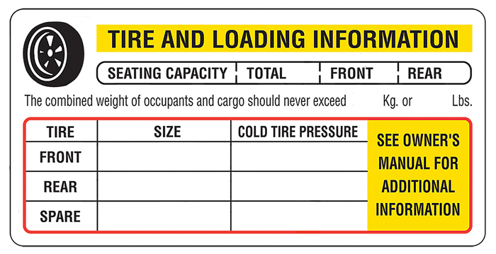
Documentation
Labels for Final Stage Certification for vehicles completed from Chassis Cab, Cutaway or incomplete Van
Additional label for vehicles with a GVWR of 10,000 lbs. or less
Placard req’d under FMVSS 110

Slide 60
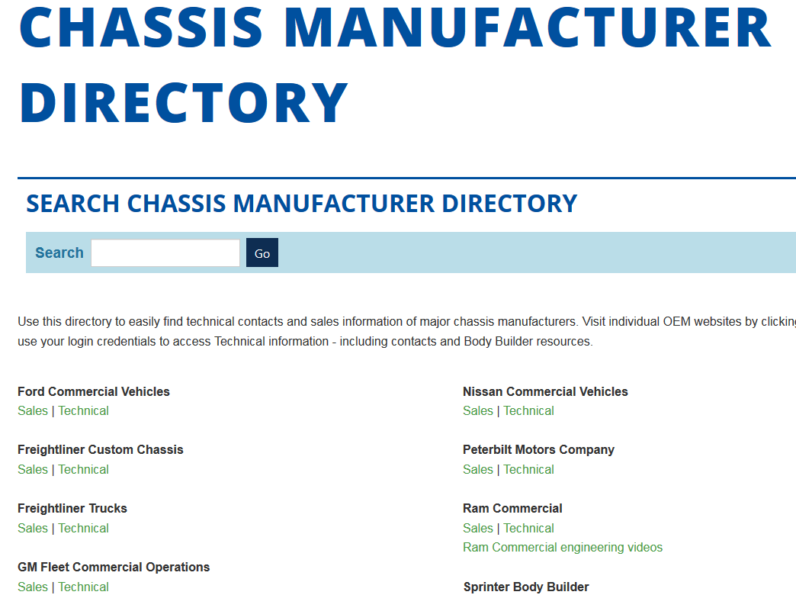
Resources
FMVSS https://www.ecfr.gov
OEM Body builder websites
Suppliers
Test labs
Designate an internal ‘compliance champion’

Slide 61

Thank you!
37400 Hills Tech Drive, Farmington Hills, MI 48331 ǀ 800-441-6832 ǀ ntea.com ǀ info@ntea.com
Requests for permission to reuse NTEA webinar content should be submitted to Joy Knesnik, NTEA communications manager, at joy@ntea.com.

Slide 62
Chassis Manufacturer Perspective
Alex Jowa
Ford QVM

Slide 63


Notes:
(Transition to BPN Update. Introduce CBM, if necessary.)

Slide 64
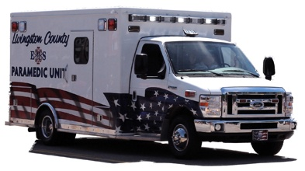
Special Vehicle Engineering
CAAS Remount Forum 6/7/17
Alex Jowa
QVM Program Engineer
Ford QVM Programs

Slide 65


Slide 66
QVM Programs
Annual QVM Program Review
  Documented Process Control
  Documented Quality Control
  Minimum Material Requirements
  Customer Support
  Completed Vehicle Underbody Inspection

Slide 67
QVM Programs
QVM Program Review is a Process Check
Ford does not “certify” the builders
Ford does not design or test builder's components , systems or “completed” vehicles

Slide 68
QVM Program Minimum Requirements
D0105
C/FMVSS and Emissions sign-off conducted annually for each model with written documentation
D0112
Builder registered with NHTSA/Transport Canada
D0113
Non-Pool Account Builder has provided proof of adequate liability insurance of $ 5M

Slide 69
QVM Program Minimum Requirements
D0114
Emissions Certificate requirements reviewed
Type: ____Dyno ___Chassis.
Reviewed for compliance, and if required, additional pathway to compliance
D0306
"Four-corner" weight analysis conducted on each model.

Slide 70
QVM Program Minimum Requirements
D0603
Vehicle sign-off is complete and the Final Stage Manufacturer Label is checked for accuracy and installation. OEM label is not removed
D0607
A passenger/cargo capacity label is installed.

Slide 71
QVM Program Minimum Requirements
D0609
Inspection hoist or pit is available.
E0404
Engineering sign-off and FMVSS 105 compliance on revised spring rate or ride height

Slide 72
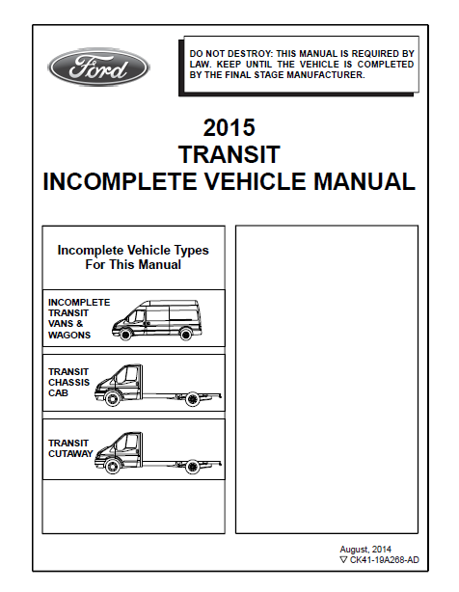
Transit Incomplete Vehicle Manual (IVM)
Available on web site www.fleet.ford.com/truckbbas under “Publications”
Max frontal areas
Max Vertical CG’s,

Slide 73
FMVSS 105 Compliance
This vehicle when completed, will conform to Standard 105, Hydraulic and Electric Brake Systems, if no alterations, modifications, or replacements are made to the following:
– Service or parking brake system
– Antilock brake system
– Vacuum system
– Wheels and tires
– Brake system indicator lamp and wiring
– Brake system reservoir label is not to be obstructed by additional underhood
components
– Suspension ride height or spring rate*
– Hydro-Boost system
– Power Steering pump and lines if used with Hydro-boost
– Engine belt drive system
– Wheelbase

Slide 74
FMVSS 105 Compliance
Aftermarket rear suspensions:
If a final stage manufacturer modifies the suspension ride height or spring rate of the factory-equipped vehicle, then they are responsible for engineering analysis or physical testing to ensure compliance and sign-off to Standard 105

Slide 75

QVM Programs
QVM Contract Signed
Manufacturers that meet QVM Program requirements are recognized as “participants” and can advertise accordingly

Slide 76
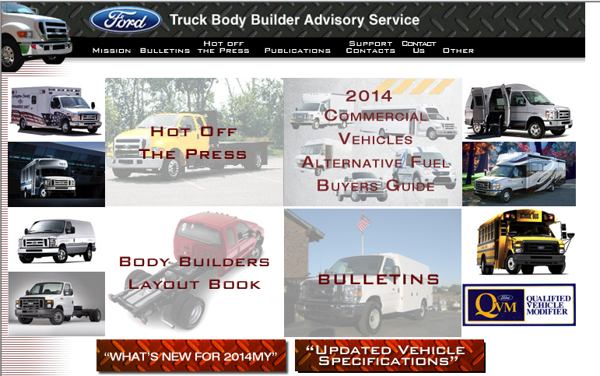
Special Vehicle Engineering
E-mail: bbasqa@ford.com Phone: 1-877-840-4338
Web Site: www.fleet.ford.com/truckbbas
Notes:
Chicago Grassroots Meeting - DraftPool Account Meeting
9/25/20174/29/09 Preliminary Draft
Ford Confidential Ford Confidential
76

Slide 77
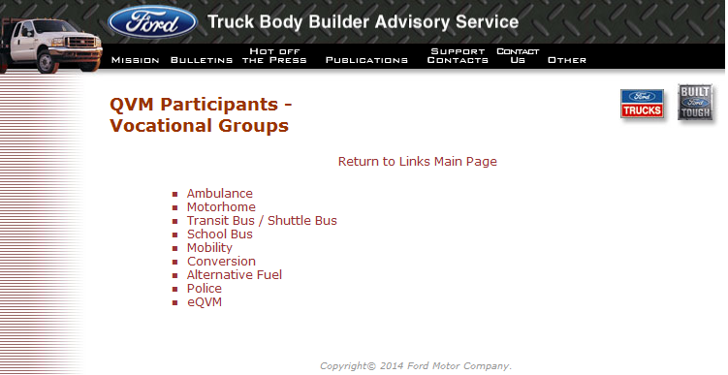
www.fleet.ford.com/truckbbas
Notes:
Electronic availability of key documents and publications (incl. Body Builder Layout Book)
Notification of upcoming products and events
Repository for Quality Bulletins
FAQ’s and answers for typical Body Builder inquiries

Slide 78

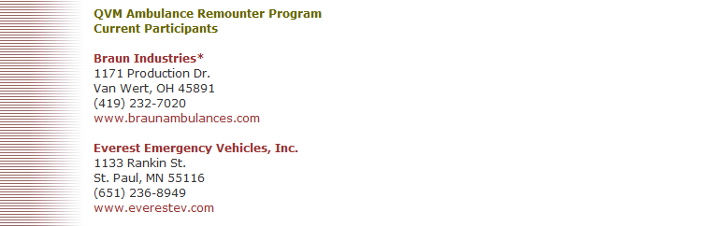
www.fleet.ford.com/truckbbas
Notes:
Electronic availability of key documents and publications (incl. Body Builder Layout Book)
Notification of upcoming products and events
Repository for Quality Bulletins
FAQ’s and answers for typical Body Builder inquiries

Slide 79
QVM Programs
THANK YOU !

Slide 81
Overview of New SAE Test Methods
Jim Green, NIOSH

Slide 82
“Star of Life” Ambulance Certification
John McDonald, GSA

Slide 83
Federal Specification for the Star-of-Life Ambulance
Presented by: John McDonald
jmcdonald@gsa.gov

Slide 84
K Sticker
“My ambulance just failed inspection. They said I need a new K sticker. I need you to send me one right away”

Slide 85
Where does the FMVSS say I have to have a “K” sticker?
It doesn’t
There is no Federal law requiring “K” stickers

Slide 86
1.1.3 “STAR OF LIFE” CERTIFICATION.
The final stage ambulance manufacturer (FSAM) shall furnish to a purchaser an authenticated certification and label stating that the ambulance and equipment comply with this specification and applicable change notices in effect on the date the ambulance is contracted for.

Slide 87
FIGURE 1 – Certification & Payload Signage
The label shall be mounted on the body (module) interior in a conspicuous location.
• The label shown here is suggested format.
• Deviations in dimensions are acceptable.
• All text must be included.
• Exceptions, when taken, shall be documented in the handbook of instructions
• No text shall be added to this label
CERTIFIED “STAR OF LIFE” AMBULANCE
Date of
Manufacture________________________________________________________________
Mfg By
____________________________________________________________________________
Address
___________________________________________________________________________
City_________________________________ __________State________Zip ______________
This ambulance conforms to Federal Specification KKK-A-1822 in effect on the date the
ambulance was contracted for
Exceptions taken? No_____ Yes_____
If exceptions are taken, they must be listed in the handbook of instructions and identified by
Section Number
Final Stage Ambulance Manufacturers ID
Number__________________________________________________________
VIN
_____________________________________________________________________________
OEM Chassis Model, Year of Manufacture __________________________________________
Vehicle Type ________________________________________________________________
NOTICE: THIS VEHICLE, AS MANUFACTURED, CONFORMS TO THE PAYLOAD
REQUIREMENTS OF THE FEDERAL AMBULANCE SPECIFICATION KKK-A-1822. USERS
SHALL NOT LOAD VEHICLES ABOVE THE GVWR, GAWRs OR EXCEED THE TOTAL
USABLE PAYLOAD OR CAPACITY LISTED BELOW.
TOTAL USABLE CARGO/EQUIPMENT CAPACITY ___________________lbs.
(Total remaining weight capacity of equipment and cargo evenly distributed in interior and exterior
compartments the user may add)

Slide 88
Where do I get a New “K” sticker?
The final stage ambulance manufacturer (FSAM) shall furnish to a purchaser an authenticated certification and label stating that the ambulance and equipment comply with this specification and applicable change notices in effect on the date the ambulance is contracted for.

Slide 89
Who Regulates Ambulances in Your State?
☒ Not GSA
☒ Not NFPA
☒ Not ASTM
☒ Not CAAS
☒ Not DOT
☑ Your State EMS Director

Slide 90
What Does My State Require?
Different in each state
Contact your state EMS Director BEFORE you remount, not after the ambulance is delivered
http://www.safeambulances.org/

Slide 91
Virginia Remount Regulation
NFPA Remount Standard
Michael Berg
VA Office of EMS
NFPA Remount Committee

Slide 92
Remounted Ambulances
Virginia Office of EMS

Slide 93
Virginia Emergency Medical Services Regulations
“12VAC5-31-810. Ground Ambulance Specifications.
B. A ground ambulance must be commercially constructed and certified to comply with the current federal specification for the Star of Life ambulance (U.S. General Services Administration KKK-A-1822 standards) as of the date of vehicle construction, with exceptions as specified in these regulations.”
http://law.lis.virginia.gov/admincode/title12/agency5/chapter31/section810/

Slide 94
Paraphrase Opinion from AG
Although there appears to be a difference between newly constructed ambulances and remounts, the regulations don’t make any such distinction. The regulation requires all ground ambulances to comply with the current federal specifications for the SOL ambulance.
(June 20, 2016).

Slide 95
Questions?
Michael D. Berg, BS, NRP
Manager, Regulation and Compliance
Virginia Department of Health
Office of Emergency Medical Services
michael.berg@vdh.virginia.gov
(804)888-9131

Slide 96

NFPA’s Ambulance Committee
The committee has begun to consider the best way to address the subject of ambulance remounts.
The committee is looking at two different options:
  Include the material as part of the next edition of NFPA 1917
  Not include it as part of the next edition but develop a new standard on it
The committee made proposed changes to NFPA 1917 during its current revision cycle so they could address this at the second draft stage

Slide 97
NFPA’s Ambulance Committee
The committee also established a task group to study the best way to address this subject and report that back to the committee.
The task group, chaired by Michael Berg, reported back to the committee that there should be a new, separate, standalone document developed to address ambulance remounts.
The full committee is meeting in August, and anyone can attend, to further work on the task groups recommendation on remounts.
Further information can be found at www.nfpa.org/1917

Slide 98
NFPA’s Ambulance Committee
Contact information:
  Dave Fischler, NFPA Ambulance committee chair, dfischler30@aol.com
  Michael Berg, Ambulance Remount TG chair michael.berg@vdh.virginia.gov
  Ken Holland, NFPA staff liaison, kholland@nfpa.org
Visit www.nfpa.org/1917 for more information on the work of the committee responsible for NFPA 1917

Slide 100
CAAS GVS Remount Forum
Open Group Discussion Topics

Slide 101
Fundamental Issues
Is the patient compartment of a remounted ambulance relevant to the year of the old chassis and body OR the year of the new chassis?
  FMVSS requirements
  Ambulance standards

Slide 102
Fundamental Issues
How do you address FMVSS requirements that relate to the patient compartment and are model year specific?
  FMVSS 206 - Door Handles (2007)
  FMVSS 207/210 – Seats and bases (2008)
  FMVSS 209 - Seat Belt Assemblies

Slide 103
Fundamental Issues
If a remounter is adding or changing seats and/or belts, how do they verify compliance with the most current version of FMVSS requirements?
If a remounter is adding or changing door handles, how do they verify compliance with the most current version of FMVSS requirements?

Slide 104
Fundamental Issues
Does the KKK certification of the original vehicle by the FSAM have any relevance following a remount?
How do you balance customer specifications, FMVSS regulations and KKK/GVS/NFPA ambulance standards?

Slide 105
Remounter
Required to be registered with NHTSA
Maintains product liability coverage?
QVM member?
ISO certified?
NTEA/AMD member?
Provides warranty coverage?

Slide 106
Process
Complies with chassis Incomplete Vehicle Manual (IVM) requirements for each chassis
Complies with Truck Body Builder Guide specific to chassis brand
Maintains appropriate compliance and engineering sign-off records
Maintains vehicle specific records relative to original and new body/chassis

Slide 107
Process
Performs engineering analysis for vehicle modifications. Examples:
  Change in chassis model
  Change in vehicle type (I to III or vice versa)
  Change in body mounting
  Change in body structure
  Change in seating and belts
  Change in litter retention system
  Installation of crash nets
  Change in or additional equipment mounting

Slide 108
Product
MUST comply with all FMVSS requirements
Do you provide any consideration for patient compartment safety requirements that may have been enacted after manufacture of original unit? Ex:
  Occupant head clearance zone
  Weight guidelines – payload and balance
  Equipment restraint for O2, monitor and fire ext.
Do you verify that the new chassis meets all requirements for the application?

Slide 109
Product
Are you offering addition of new CN #8 (2015) SAE features on remounts?
  SAE J3026 compliant seating
  SAE J3027 compliant litter retention
  SAE J3043 compliant equipment mounting
Does the original unit meet SAE minimum requirements of CN#10 (2017)?
  SAE J3057 Modular Body Integrity
  SAE J3058 Interior Cabinet Integrity
  SAE J3102 Floor Load

Slide 110
Product
Do you perform modifications on or install new systems that require FDA compliance?
  Litter mount and cot
  Cot restraint straps
  Suction system
Do you perform any analysis or repair on litter mounts and cots that have been damaged by accident?

Slide 111
Product - Documentation
Do you provide required FMVSS compliance vehicle stickers?
Do you provide vehicle stickers showing original body information and including remount specific information for new unit?
Do you provide vehicle stickers with basic information on weight and payload, tire pressure, O2 test, etc?
Do you leave original stickers on the unit?

Slide 112
Product - Documentation
Do you provide documentation showing information on original vehicle and remounted vehicle?
Do you provide an owner’s manual with important information on vehicle? Ex:
  Operator manual for any furnished equipment
  Warranty information
  Weight and payload documentation

Slide 113
AMD Standards
AMD standards are performance tests that work in conjunction with the Star of Life KKK specifications to verify that certain requirements of the specification are met.
All AMD standards are in addition to, and in no way a substitute for FMVSS and other federal requirements that apply to all motor vehicles including ambulances.

Slide 114
AMD Standards
AMD 001 Ambulance Body Structure Test
AMD 003 O2 Tank Retention System Test
AMD 004 Litter Retention System Test
AMD 005 Low Voltage Electrical Test
AMD 006 Patient Compartment Sound Test
AMD 007 Patient Compartment CO Test
AMD 008 Patient Compartment Handrail Test

Slide 115
AMD Standards
AMD 009 125 VAC Electrical Test
AMD 010 Water Leak Test
AMD 011 Equipment Temperature Test
AMD 012 Interior Climate Control Test
AMD 013 Weight Distribution Guidelines
AMD 014 Engine Cooling System Test
AMD 015 Main Medical Gas Test

Slide 116
AMD Standards
AMD 016 Patient Compartment Lighting Test
AMD 017 Road Test
AMD 018 Rear Stepping Surface Test
AMD 019 Measuring Guide for Cabs/Compts.
AMD 020 Floor Distributed Load Test
AMD 021 Aspirator System Test
AMD 022 Cold Engine Start Test

Slide 117
AMD Standards
AMD 023 Siren Performance Test
AMD 024 Perimeter Illumination Test
AMD 025 Occupant Head Clearance Zone Test
AMD 026 Emergency Lighting Configuration
AMD 027 Line Voltage Electrical Test

Slide 118
Modular Body Collisions
Do you do major body repairs involving structural damage?
How do you evaluate scope of damage and process of repair from a structural standpoint?
  Major repairs can be poorly done or done by unqualified shops, driven by insurance carrier
  Body structural integrity can be affected
  Major body repairs may affect OEM body certification

Slide 119
Next Steps
Establish a Remount Standard Work Group to develop recommendations to be provided to CAAS GVS Comm. for consideration in GVS V.2.0.
Apply online at www.groundvehiclestandard.org
Work group will be designated through ANSI guidelines. Members will be balanced by principal activity of applicants.
First meeting tentatively to be held this fall, all are welcome to attend.

Slide 120
Questions?

